Slide 1
GETTING SAFER… Reducing P & PF Food Establishment Violations (Category IV)
Cabarrus Health Alliance
August 17-21, 2015

Slide 2
The Power of the Team
Jennifer Hatley QI Leader, Food & Lodging Staff
Jim Osborne Food & Lodging Supervisor
Mary Barbee Food & Lodging Staff
Carie Irving Food & Lodging Staff
Daniel Squirewell Food & Lodging Staff
Julia Patterson Accreditation Director
Emma Zelaya CC4C Care Manager/Wildcard
Karen T. Barbee President, Troutman BBQ Rest.
Nikolas Katsanos Owner, Harrisburg Family House
Karren Kwong Owner, E Noodles & Co.
Adam Hart Fatz

Slide 3
What Is Our Gap?
Gap: ~ 1600 Priority / Priority Foundation violations in the 12 months, in risk category #4 establishments.
Vision:
To maintain a decreased number of P/PF violations noted during routine inspections while maintaining 100% inspection compliance
Decrease the risk of Foodborne Illness (FBI) to residents and visitors of Cabarrus County
Continued/improved compliance with the NC Food Code Manual and improved sanitation scores

Slide 4
Our Goal
TO: | What is the goal, purpose or outcome desired? Decrease the number of P/PF violations in risk category IV establishments.
FOR: | Who benefits from the results? What is the scope? • CHA Environmental Health Food & Lodging Staff • Owners/General Managers/Employees of food service establishments located in Cabarrus County • Residents or visitors who eat at establishments in Cabarrus County
SO THAT: | What are the benefits from achieving the goal? • Decrease the risk of FBI • Improve quality of working relationships with owners/operators and increase on-going knowledge of P/PF violations for PIC
COND-ITIONS: | • Participation of CHA Food & Lodging staff & establishment Owners/Operators • Cannot change regulations 100% food inspections completed

Slide 5
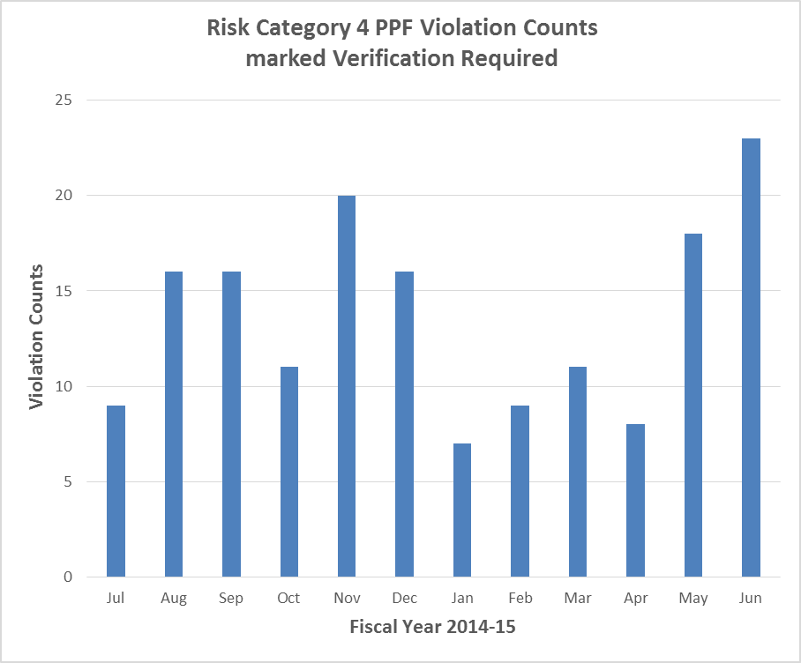
Our Goal Cont’d.
Measures
~ 475 less P/PF
Violations per year
Beneficiaries | What Measured | How Measured | Target
 |  |  | How Much | By When
Risk category IV Establishments | Number of P/PF Violations | Data from DHD | 30% reduction in P/PF Violations | 6 months post Kaizen Event

Slide 6
Results
Decrease Category IV Priority / Priority Foundation violations
Improve our working relationships
Getting Safer…Education Materials for the PIC & all employees (handouts/website):
Active Managerial Control definition
P/PF Top 10 examples
Proper cooking time & temps
Date marking (ready to eat foods)
How to temp foods
Managing hot/cold temperatures
Proper cooling procedures
Dishwashing 3 sink method
Personal cleanliness
Store chemicals properly
By using:
Follow-up on CDI protocol
Logging CDI violations for routine follow up
Website tools & resources (education material, links, videos, handouts, code, etc…)
Routine Getting Safer education
Quarterly email newsletters
Annual food safety training
Concentrated time with establishments with more violations

Slide 7
A Little Background on Continual Quality Improvement & Kaizen

Slide 8
Continual Quality Improvement
Achieving sustainable performance beyond what is thought possible by unlocking the limitless capacity of an organization’s most valued resource – its people Through the identification of focused improvement areas, elimination of non-value added work through the use of improvement methods (like Kaizen) to diagnosis and solve problems, test solutions, measure results, learn, and install sustainable change

Slide 9
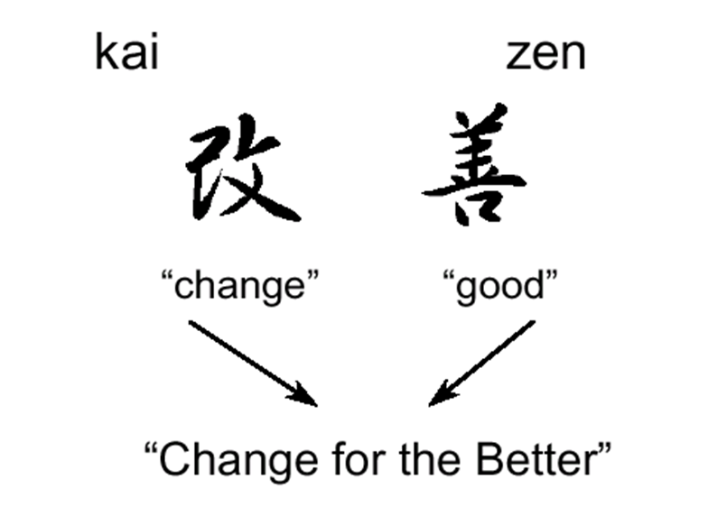
Our approach … Kaizen
A group of methods for making work process improvement. Planned team event conducted in the workplace, systemically uncovering waste in a work process, and eliminating it in rapid fashion…

Slide 10
Our Own In-House Kaizen Event Leader

Slide 11
The Improvement Cycle & Kaizen
Improvement Cycle: (6-8 months)
Plan/Solve
Do / Try
Check / Learn
Act/Install
Kaizen Event Steps: (6 weeks)
Confirm
Prepare
Perform
Institutionalize
Pre-Event
Event
Post-Event
Work Time: 30 min
Elapsed Time: 1 day
Work Time: 12 hrs
Elapsed Time: 3 wks
Work Time: 20 hrs
Elapsed time: 2 wks
Work Time: 40 hours
Elapsed Time: 5 days

Slide 12
Value Is
Anything that
the customer recognizes as valuable and is willing to pay for, AND
Changes the product or information, AND
Is done right the first time.
Waste Is
Anything that consumes resources without
adding value
Value
Waste
Notes:
12

Slide 13
Waste Presents Itself in Different Forms
Moving
Stopping
Searching
Inspecting
Getting Ready
Things Gone Wrong
More Than Needed
Not Needed
Underutilized Potential
Characteristics:
Observable symptoms; categories of issues
Measureable / quantifiable
One waste can cause another waste
Notes:
13

Slide 14
Our event Reducing Category IV Priority & Priority Violations

Slide 15
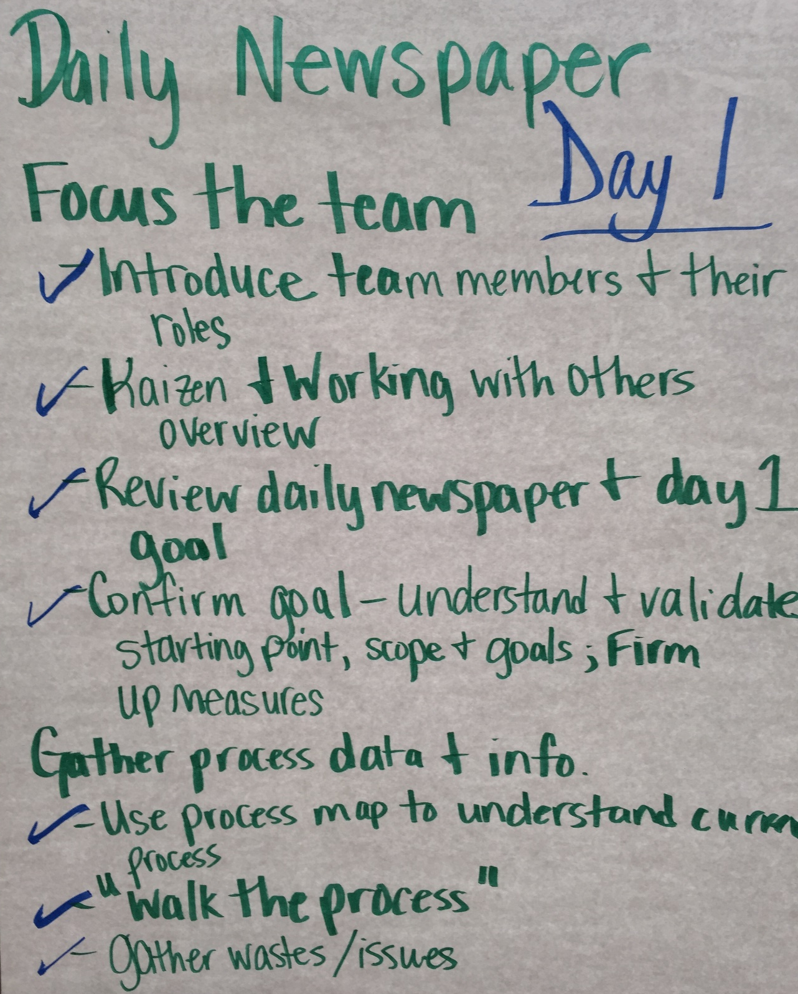
Day 1

Slide 16
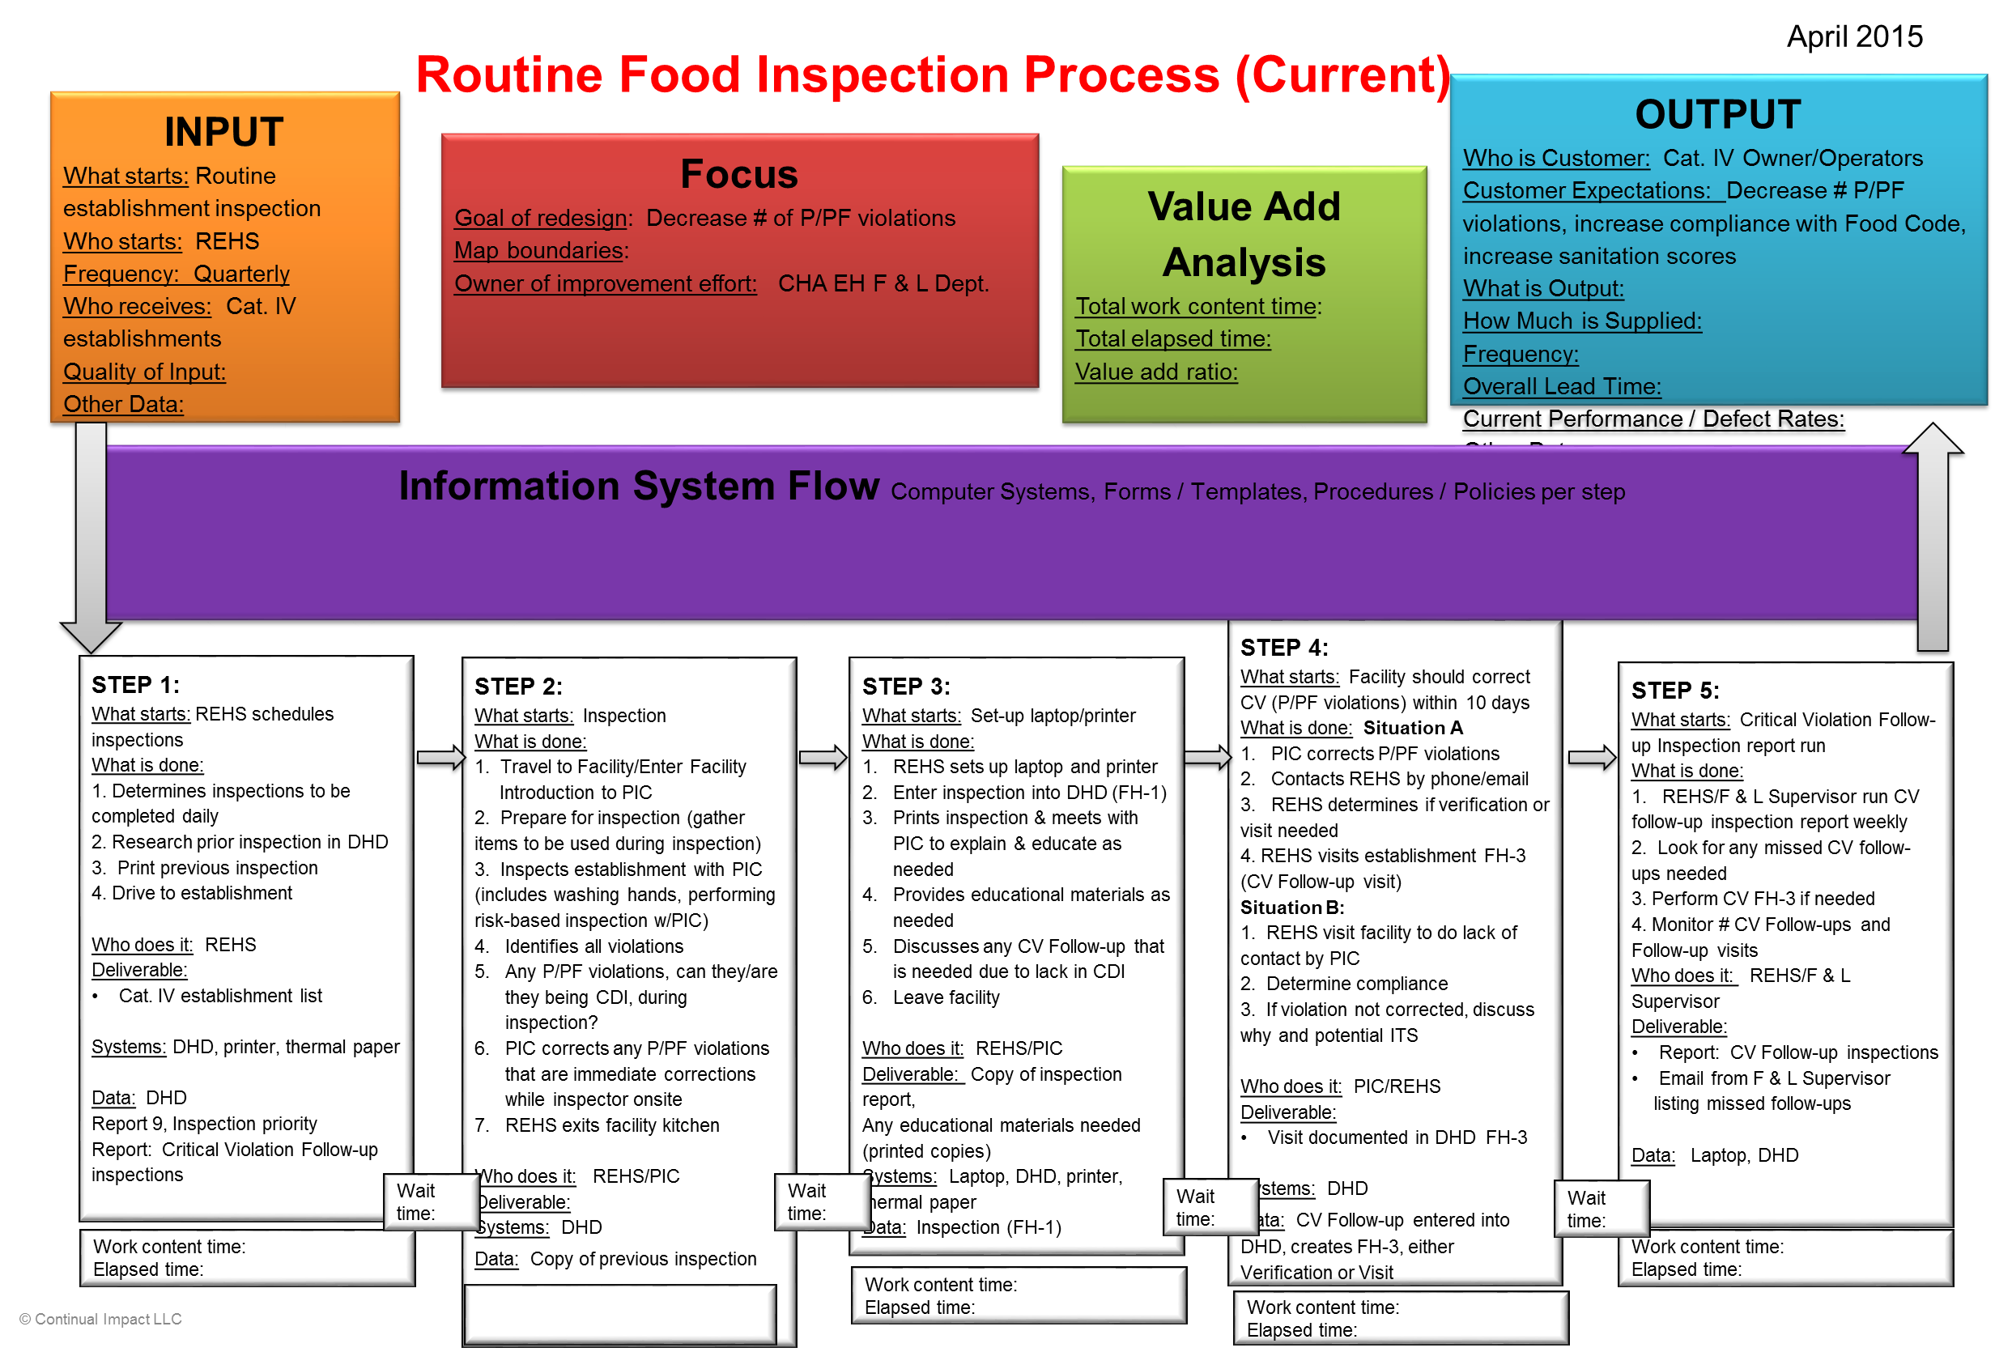
Our Current Process

Slide 17
Understanding Our Current Performance Top P/PF Violations

Slide 18
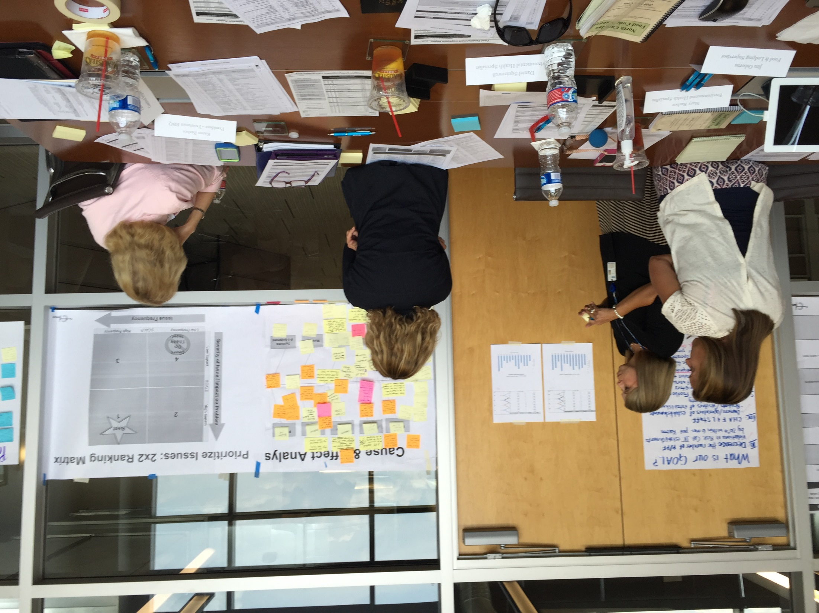
Hmm…What Are The Issues Causing Priority Violations?

Slide 19
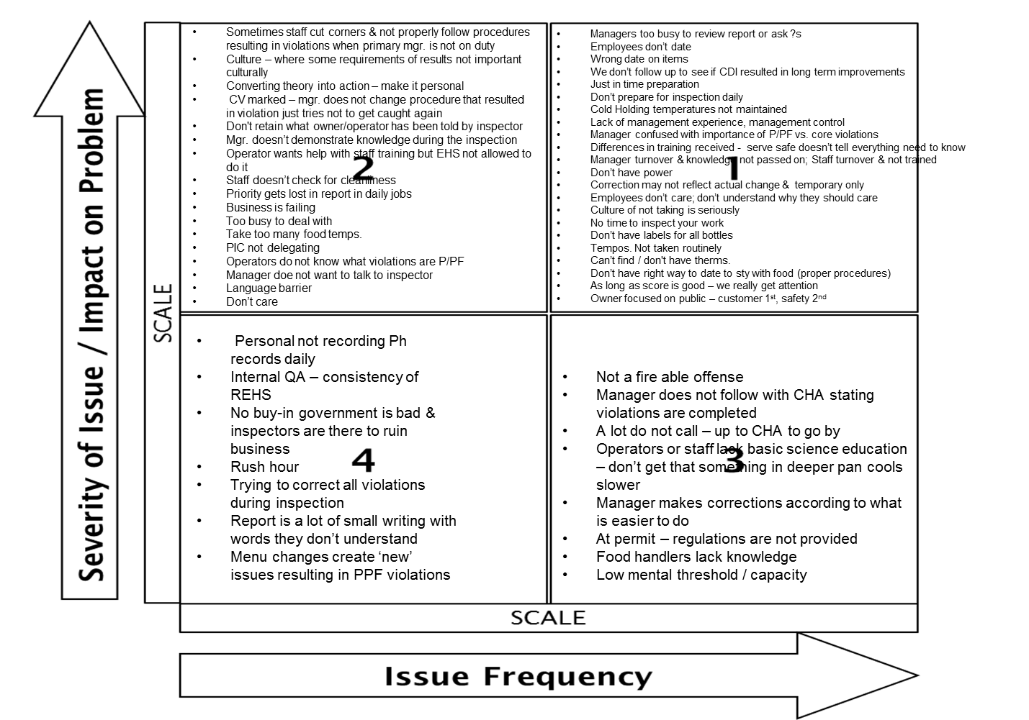
Capturing Wastes & Issues

Slide 20
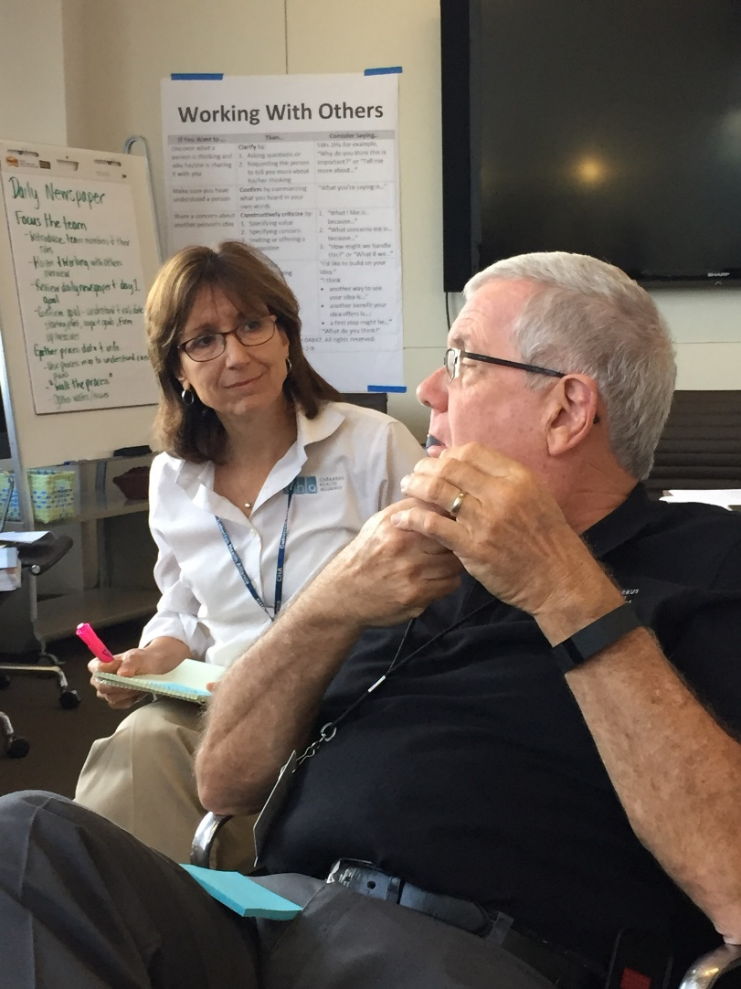
Our High Impact Frequent ISSUES/WASTES
Managers too busy to review report or ask ?s Incomplete or improper date on items Inconsistent follow up to see if CDI resulted in long term improvements Preparing for inspection Just in time Don’t prepare for inspection daily Cold Holding temperatures not maintained Lack of management experience, management control Manager confused with importance of P/PF vs. core violations

Slide 21
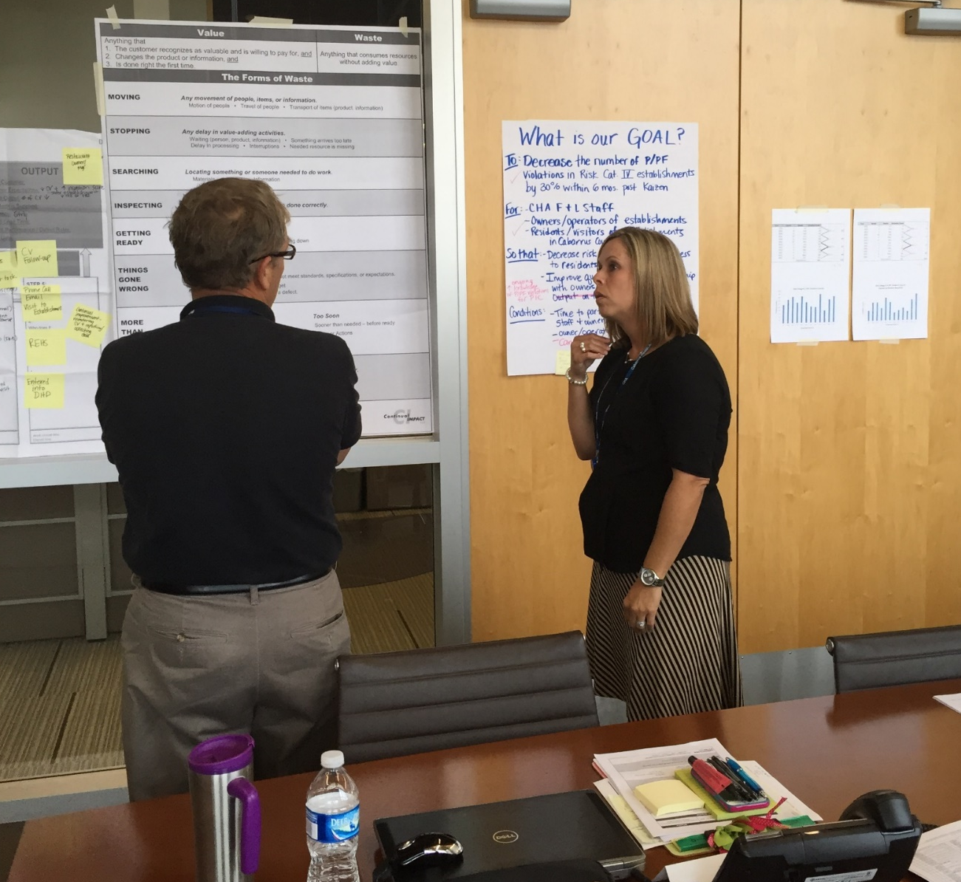
Communicating Progress

Slide 22
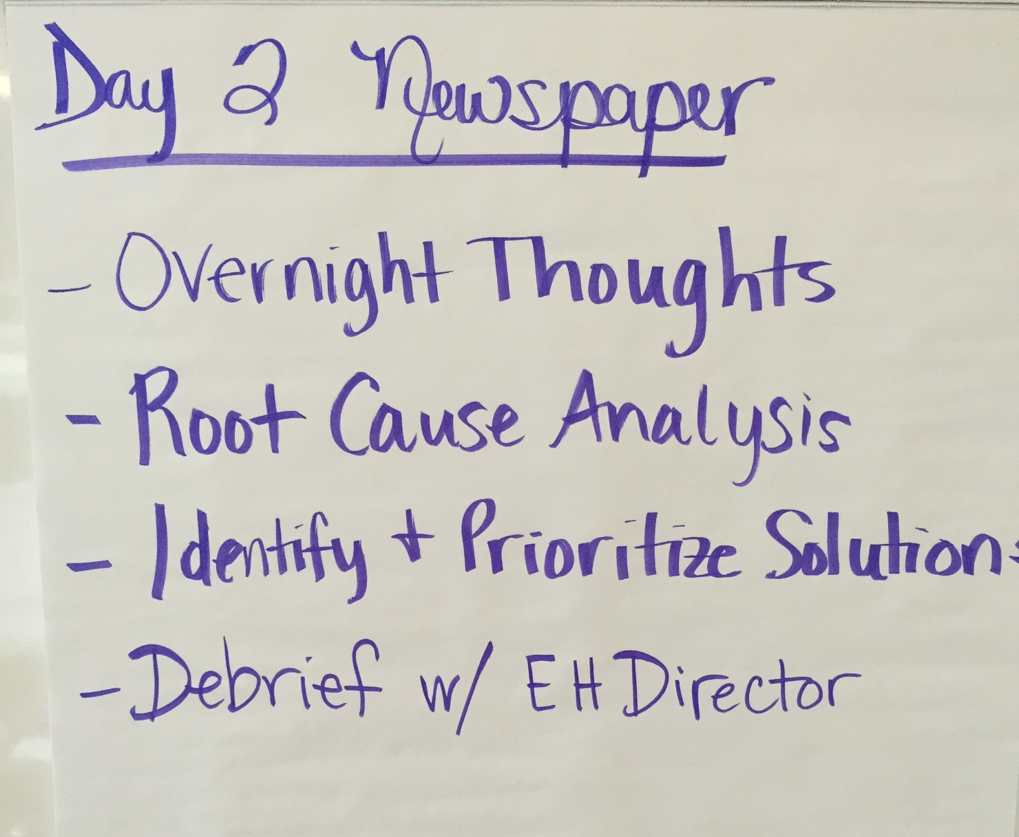
Day 2

Slide 23
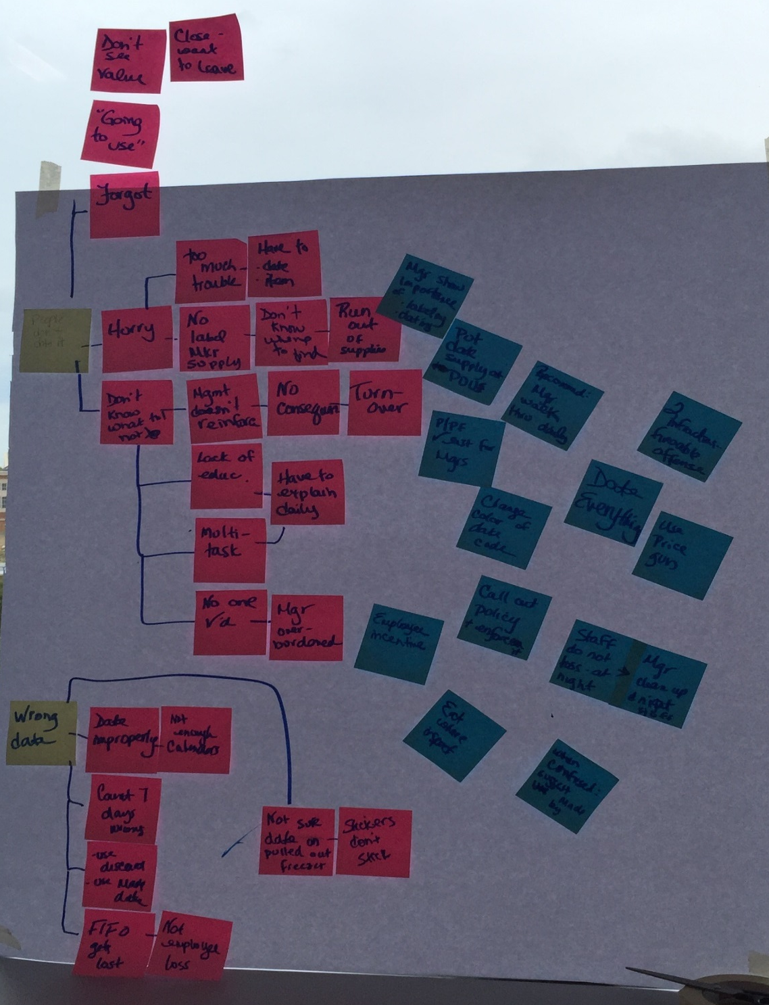
Getting To The Root Of The Big Issues
Solution
Issue
Cause-Effect

Slide 24
Root Cause Analysis: Asking Why, Why, Why, Why, Why
Managers too busy to review report or ask ?s Employees don’t date Wrong date on items We don’t follow up to see if CDI resulted in long term improvements Just in time preparation Don’t prepare for inspection daily Cold Holding temperatures not maintained Lack of management experience, management control Manager confused with importance of P/PF vs. core violations

Slide 25
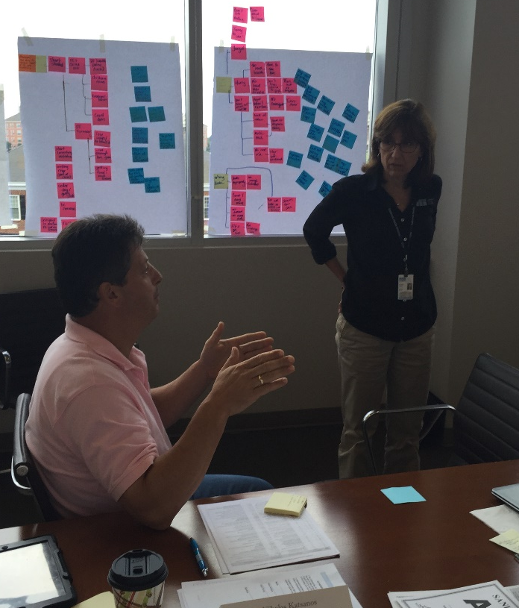
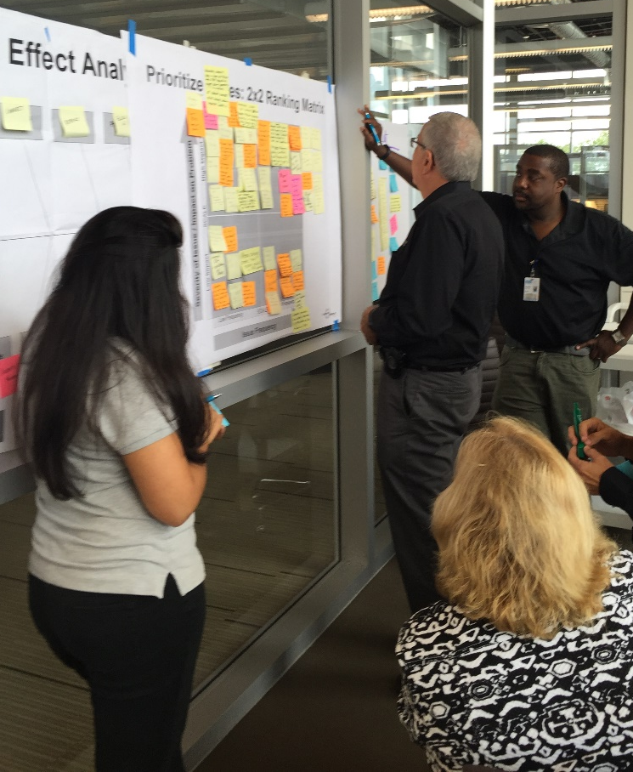
Prioritizing Solutions to Be Developed and Tested

Slide 26
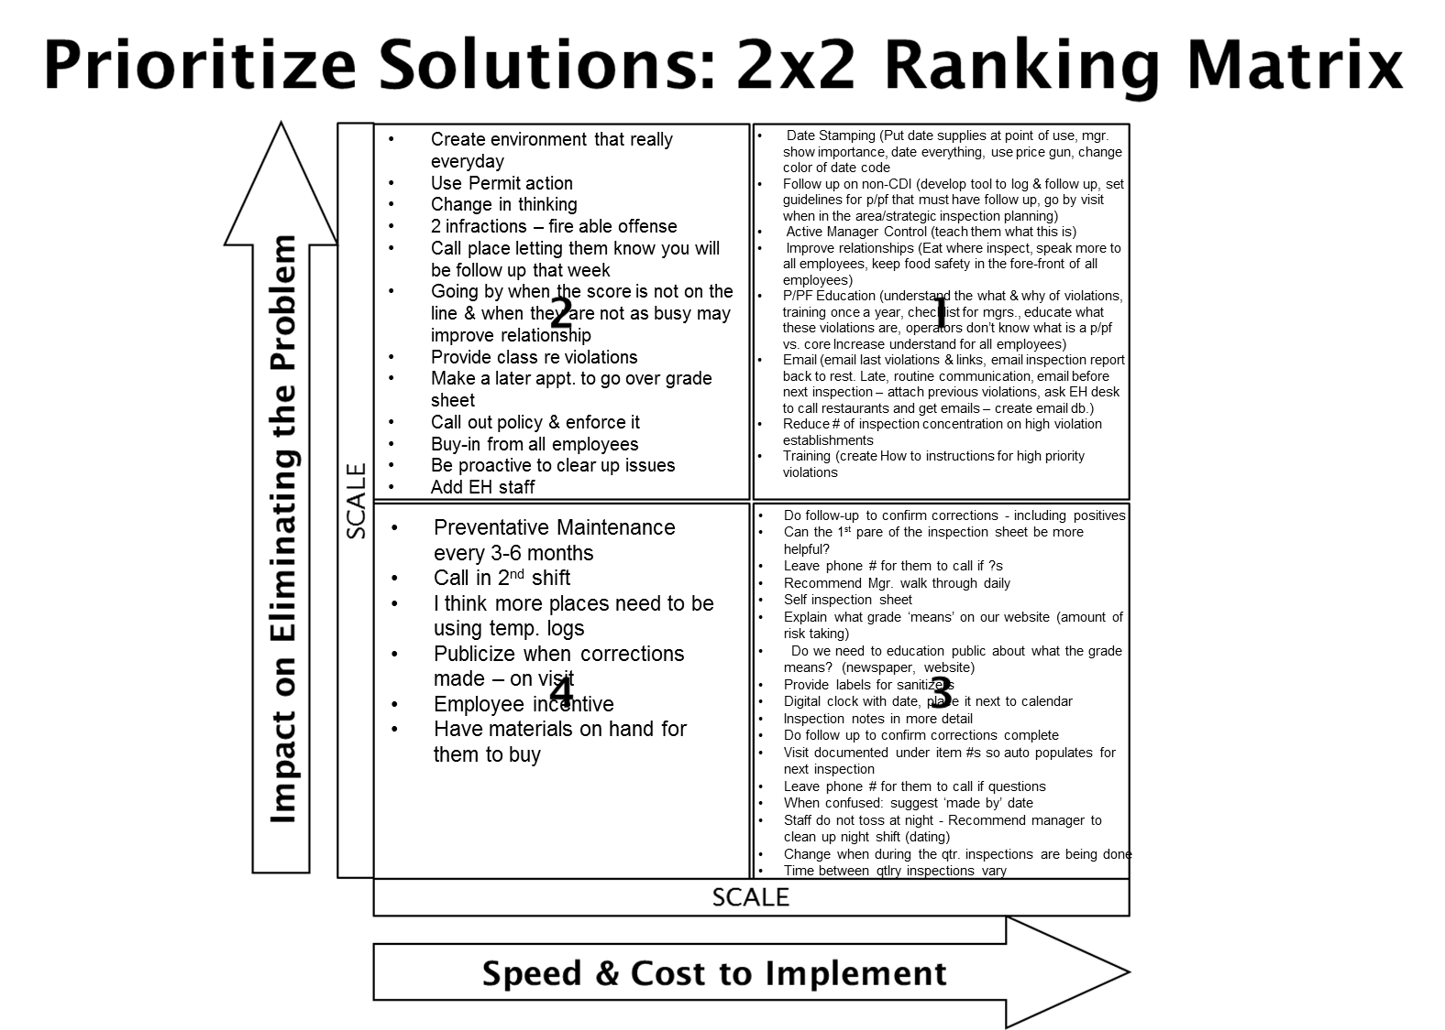
Prioritized Solutions

Slide 27
Day 3 Validate solutions will achieve the goal Develop, Test, Learn Develop, Test, Learn
Notes:
Make this personal

Slide 28
Improvement Hypothesis
Issue | Improvement | Expected Results
Most frequently occurring violations hot & cold holding temperatures are not maintained Improper date marking & disposition Improper identification, storing, & using toxic substances Improper cleaning & sanitizing of food contact surfaces | If we…provide How To instructions for all employees | Then…priority & priority foundation violations will decrease and food safety knowledge in all employees increases so that establishments are always in compliance (daily).
Inconsistent follow up to see if CDI resulted in long term improvements | If we…develop a tool/document to log CDI violations and routinely follow up on CDI items and use strategic inspection planning | Then…we should see long term decrease of priority & priority foundation violations.
Lack of management (PIC) time to review report or ask ?s, control, and understand the importance of P/PF vs. core violations Establishment employees preparing for inspections Just in time and not routinely | If we…engage with PIC and the food handlers during the inspection AND provide targeted P/PF education, Active Management Control responsibilities, AND routine knowledge (Email blasts, website, annual training) | Then…CHA & food establishments will have improved working relationships, PICs will take more ownership, and violations will decrease.

Slide 29
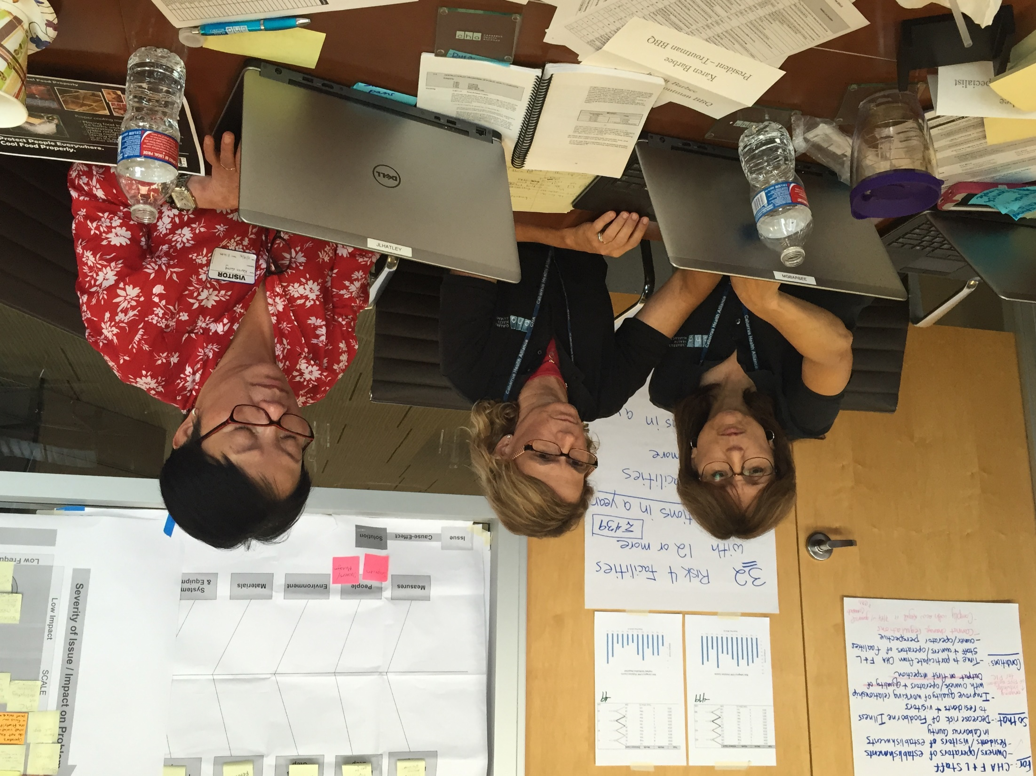
Developing Our Solutions Inspectors & Restaurant Owners Together

Slide 30
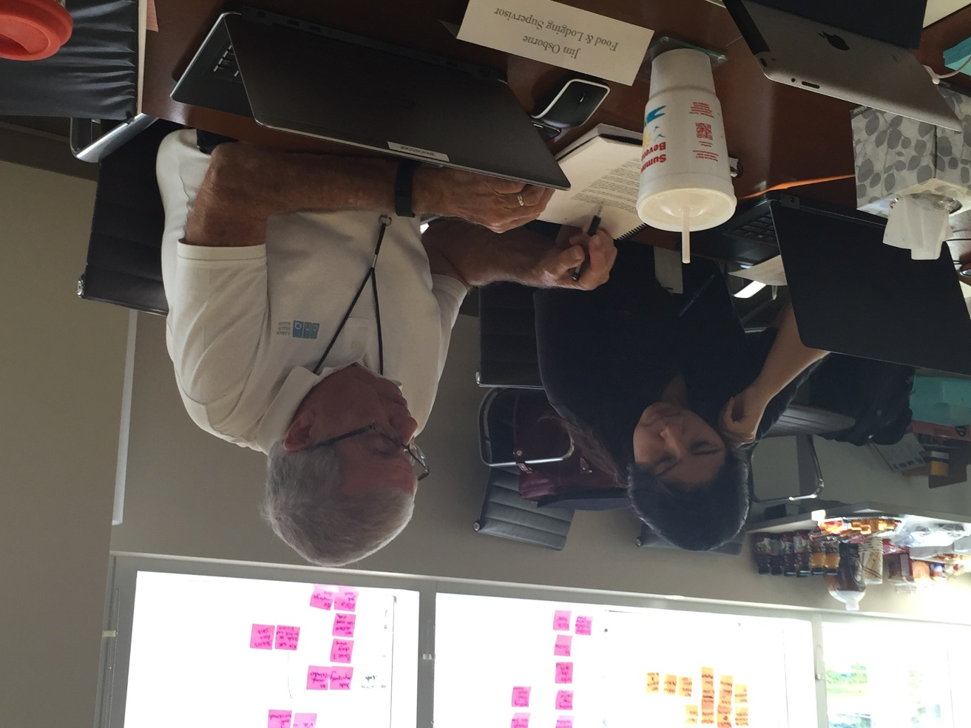
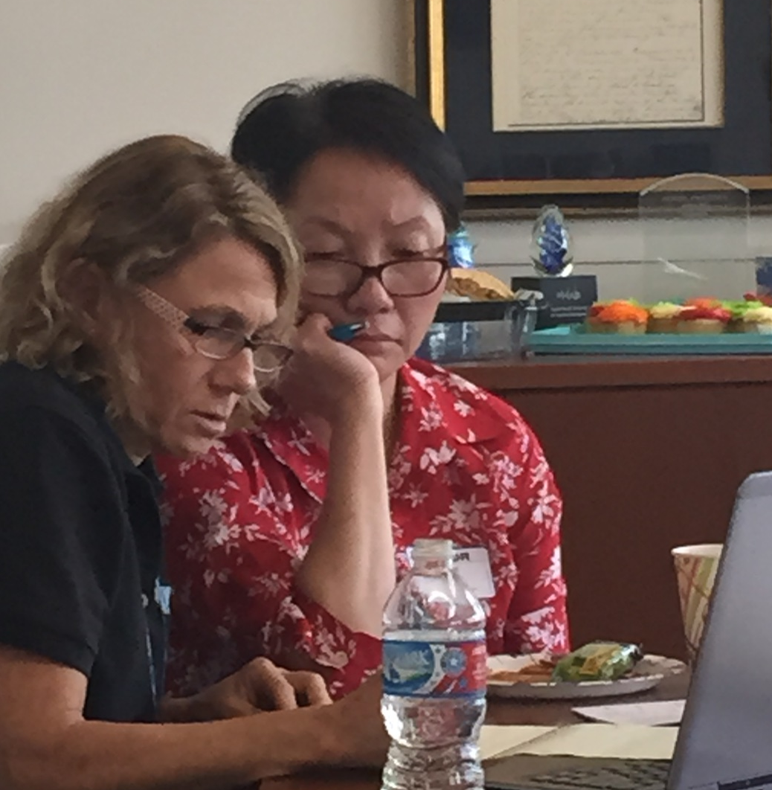
More Solution Development

Slide 31
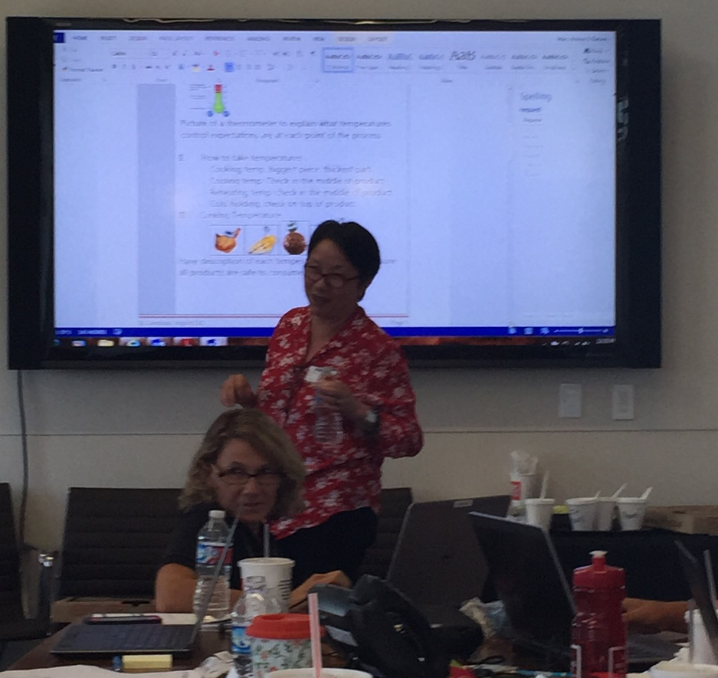
Testing Our Solutions

Slide 32
Results
Decrease Category IV Priority / Priority Foundation violations
Improve our working relationships
Getting Safer…Education Materials for the PIC & all employees (handouts/website):
Active Managerial Controls definition
P/PF Top 10 examples
Proper cooking time & temps
Date marking (ready to eat foods)
How to temp foods
Managing hot/cold temperatures
Proper cooling procedures
Dishwashing 3 sink method
Personal cleanliness
Store Chemicals Properly
By using:
Follow-up on CDI protocol
Logging CDI violations for routine follow up
Website tools & resources (education material, links, videos, handouts, code, etc…)
Routine Getting Safer education
Quarterly email newsletters
Annual food safety training
Concentrated time with establishments with more violations

Slide 33
Day 4
“We’ve never had tools like this to help keep food safety on their minds.”
“This is not just about the PIC, it is about all employees.”

Slide 34
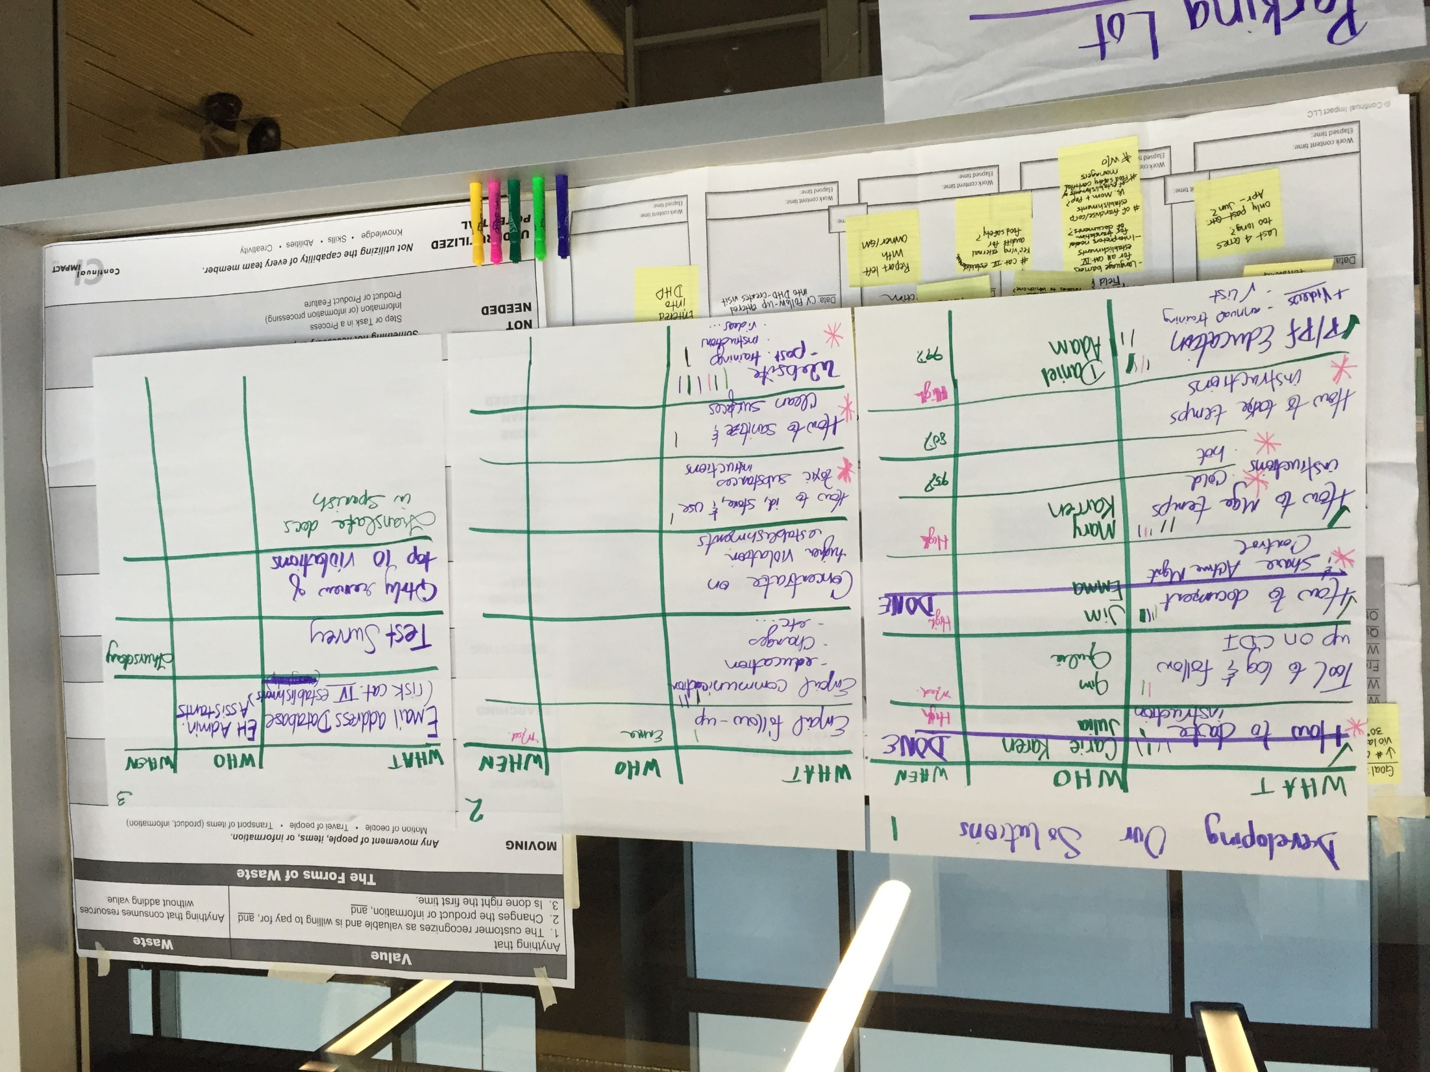
Getting Things Done!

Slide 35
Testing Solutions with Food Establishments
Tests | How | When | Who | Successful if…
How to instructions by P/PF | Choose a follow Up visit on Qtr. 1 establishments with CDI P/PF violations | Thursday Lunch | Mary, Daniel, Emma | Guideline handout feedback – Agree / Strong Agree Verbal feedback Provided
Email follow up | Choose a follow Up visit on Qtr. 1 establishments with CDI P/PF violations | Thursday Lunch |  | Learn if establishment would like email
How to guidelines | Classroom test with Establishment owners | Thursday, Friday | Team | Guidelines are simple, printable, & Accessible
Notes:
Protocols, training on ELR

Slide 36
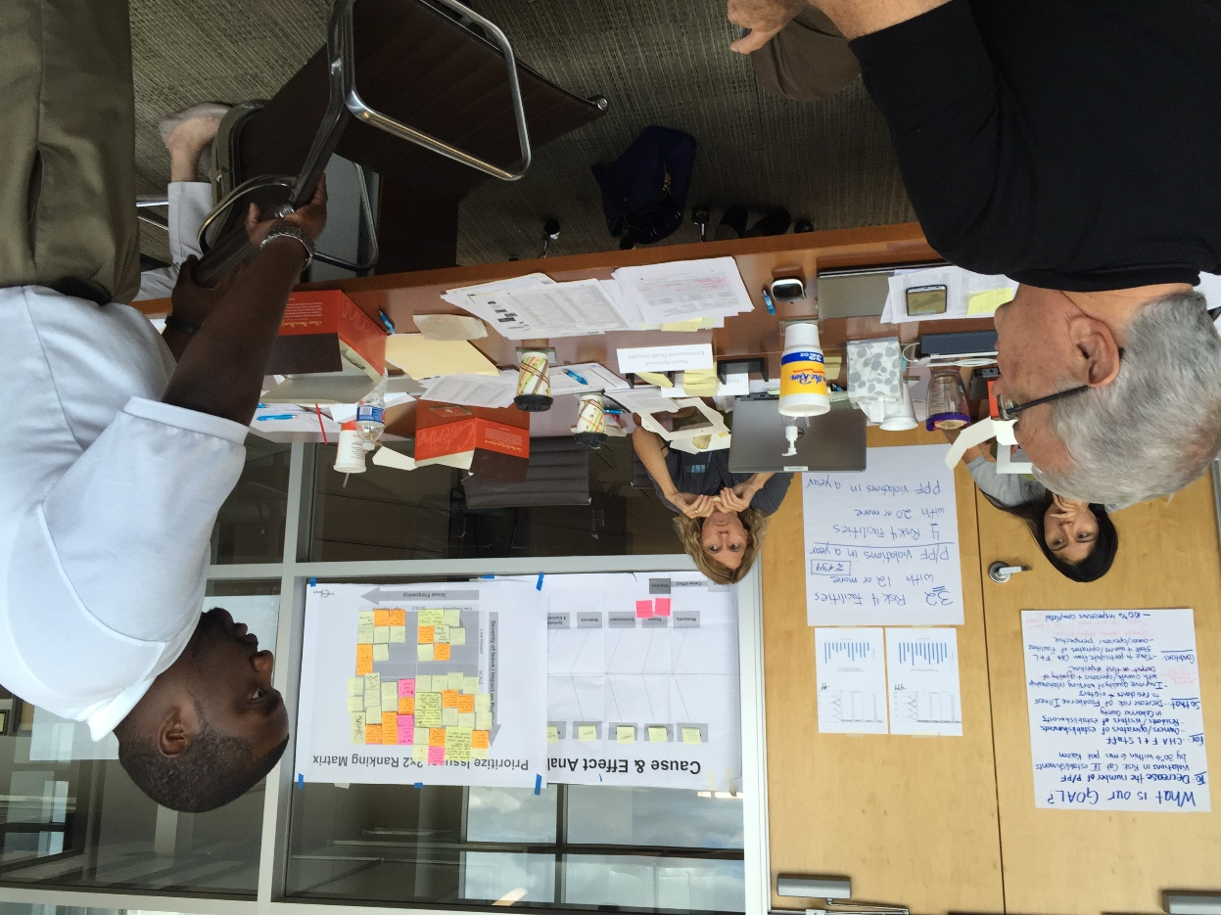
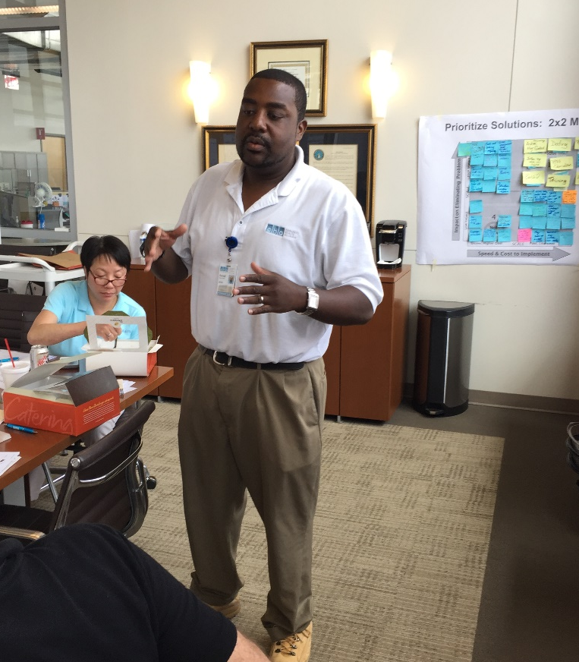
Preparing For Our Tests

Slide 37
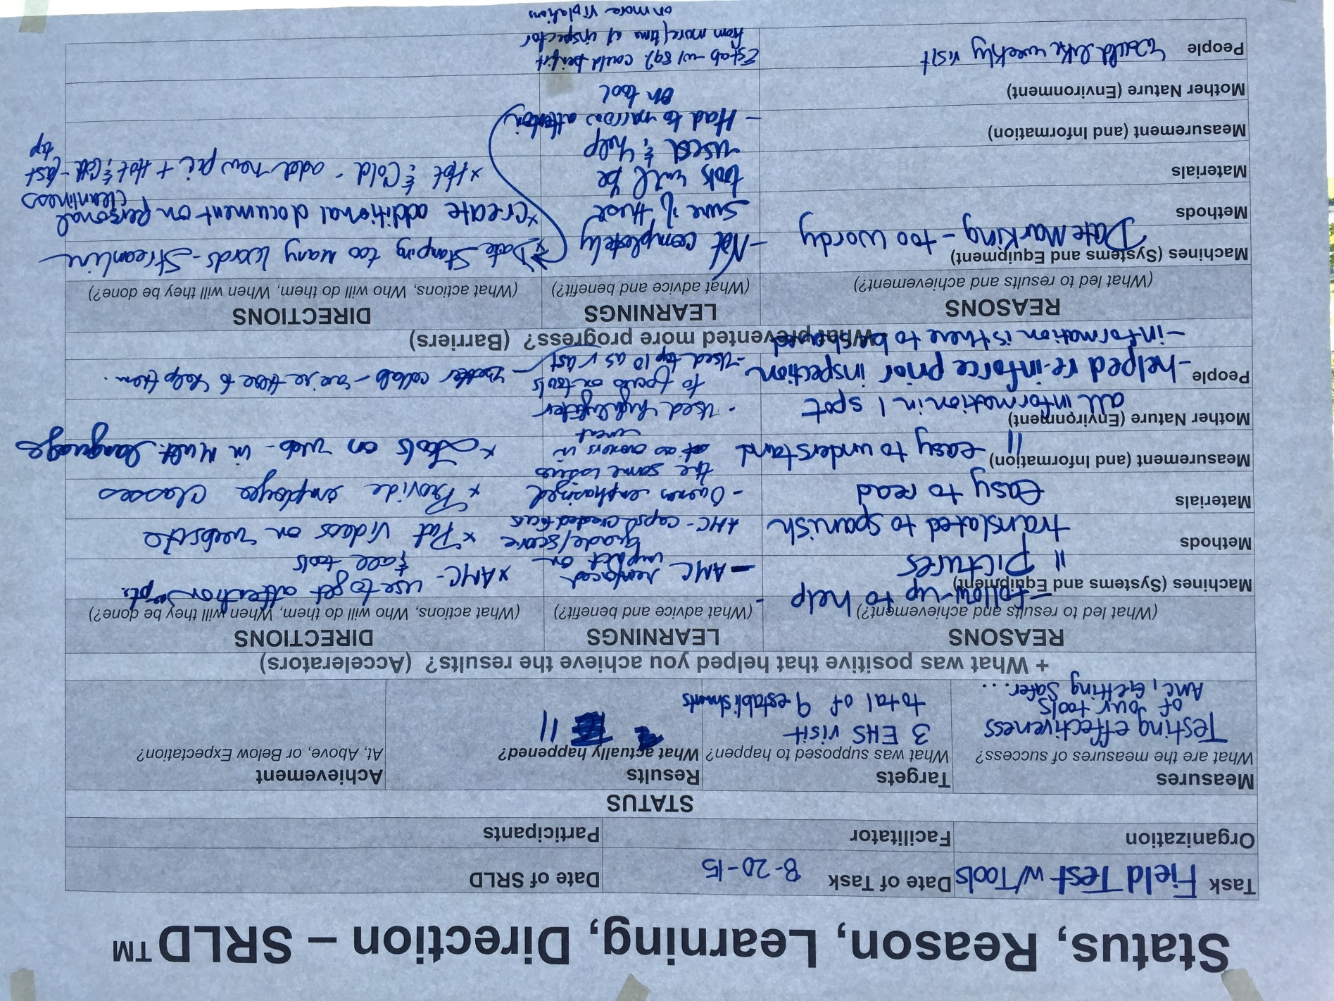
Learning From Our Testing
9 Follow-Ups
11 surveys completed
Use multi-language education material & videos on website
Provide employee classes
Handouts with pictures are easy to understand
Simplify the Date Marking handout
Create additional 1 page handouts

Slide 38
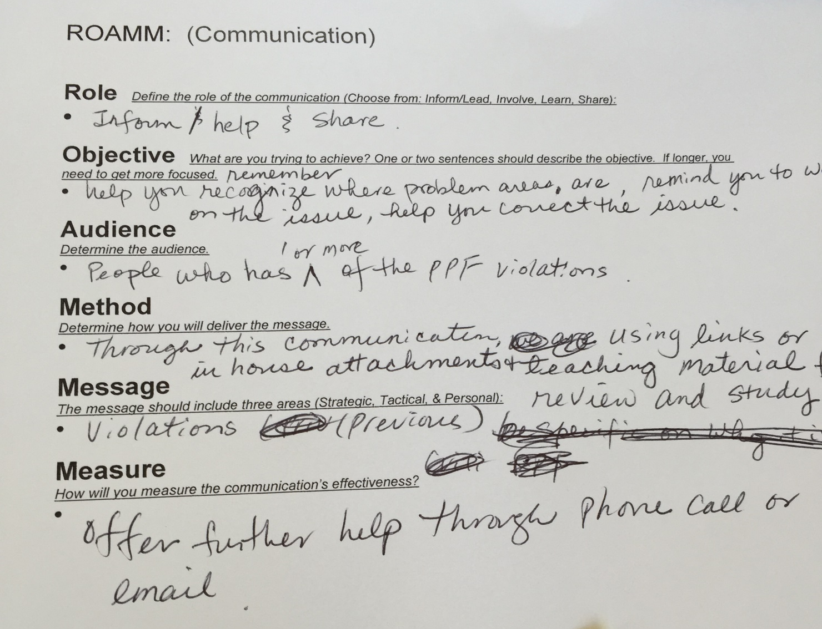
What Do Our Customers Want? Developing Communications

Slide 39
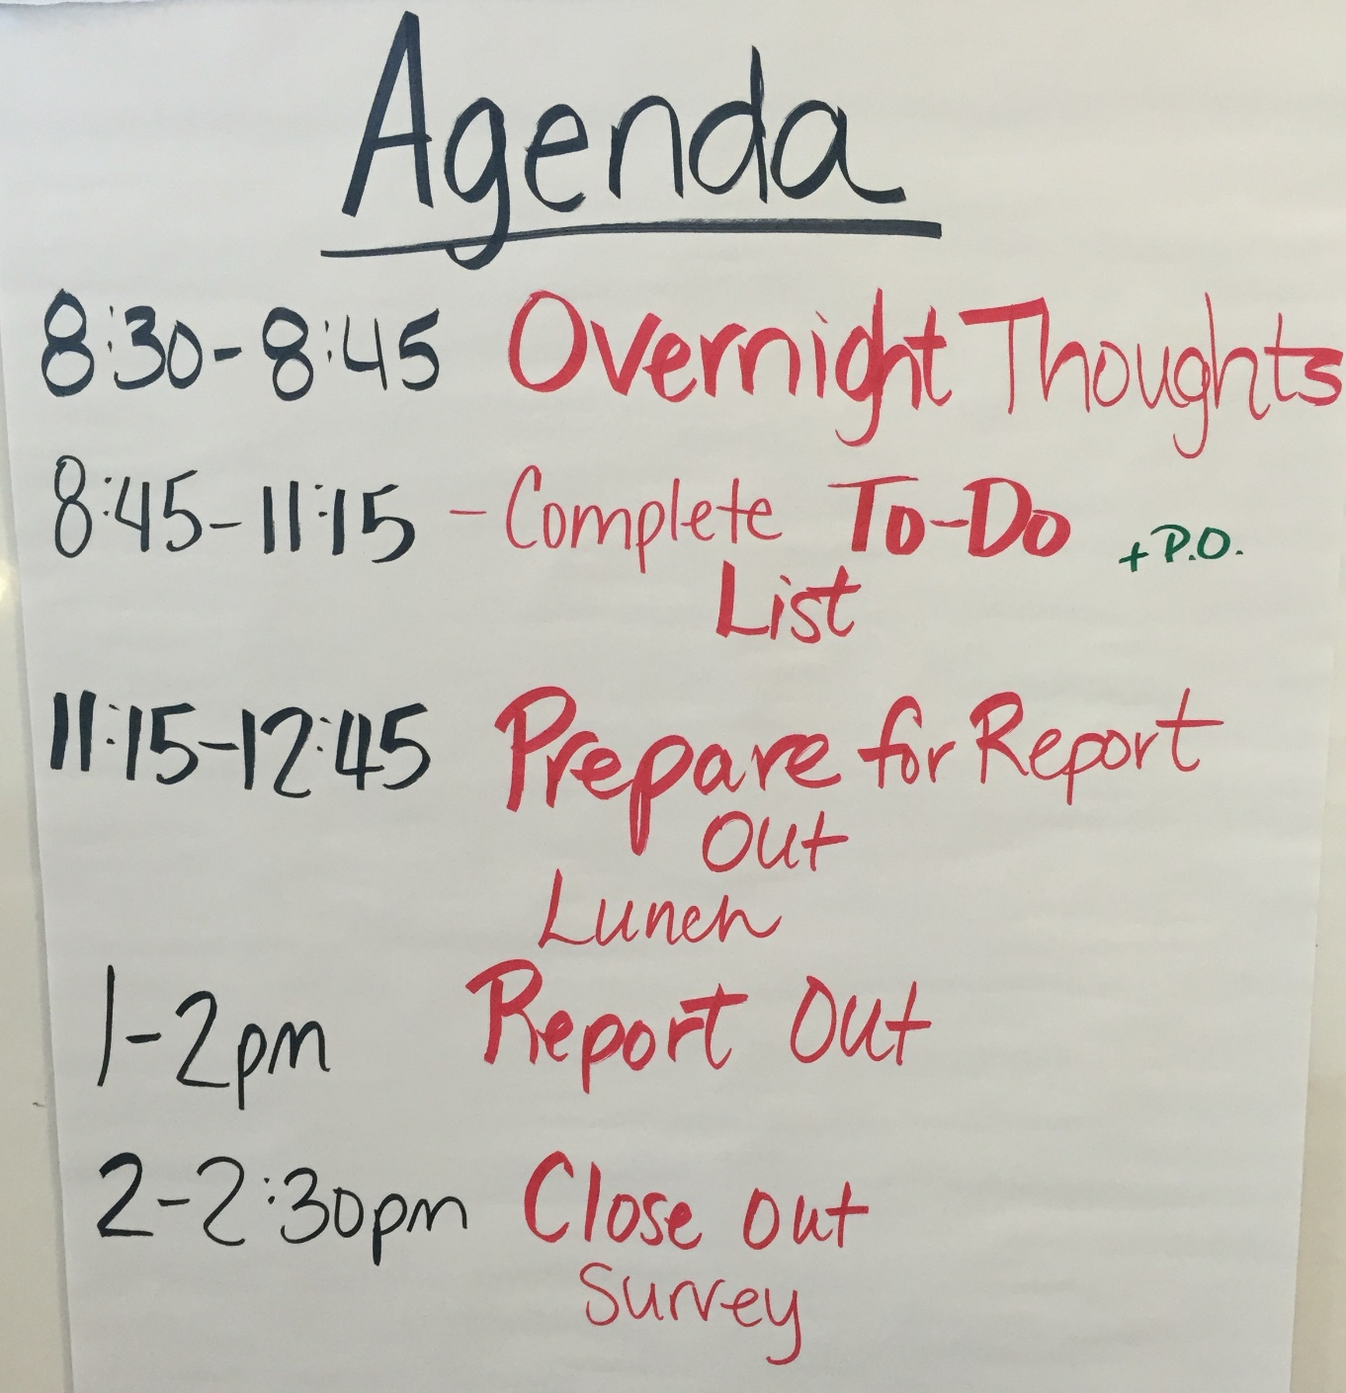
Day 5
Notes:
Make this personal

Slide 40
Rollout Plan
Monday
1 page tools (English)
September
1 Page tools in Spanish
November + Quarterly
Email Newsletters
Website with tools & resources
CV Follow-up visits for CDI
Open food safety training (for PICs)

Slide 41
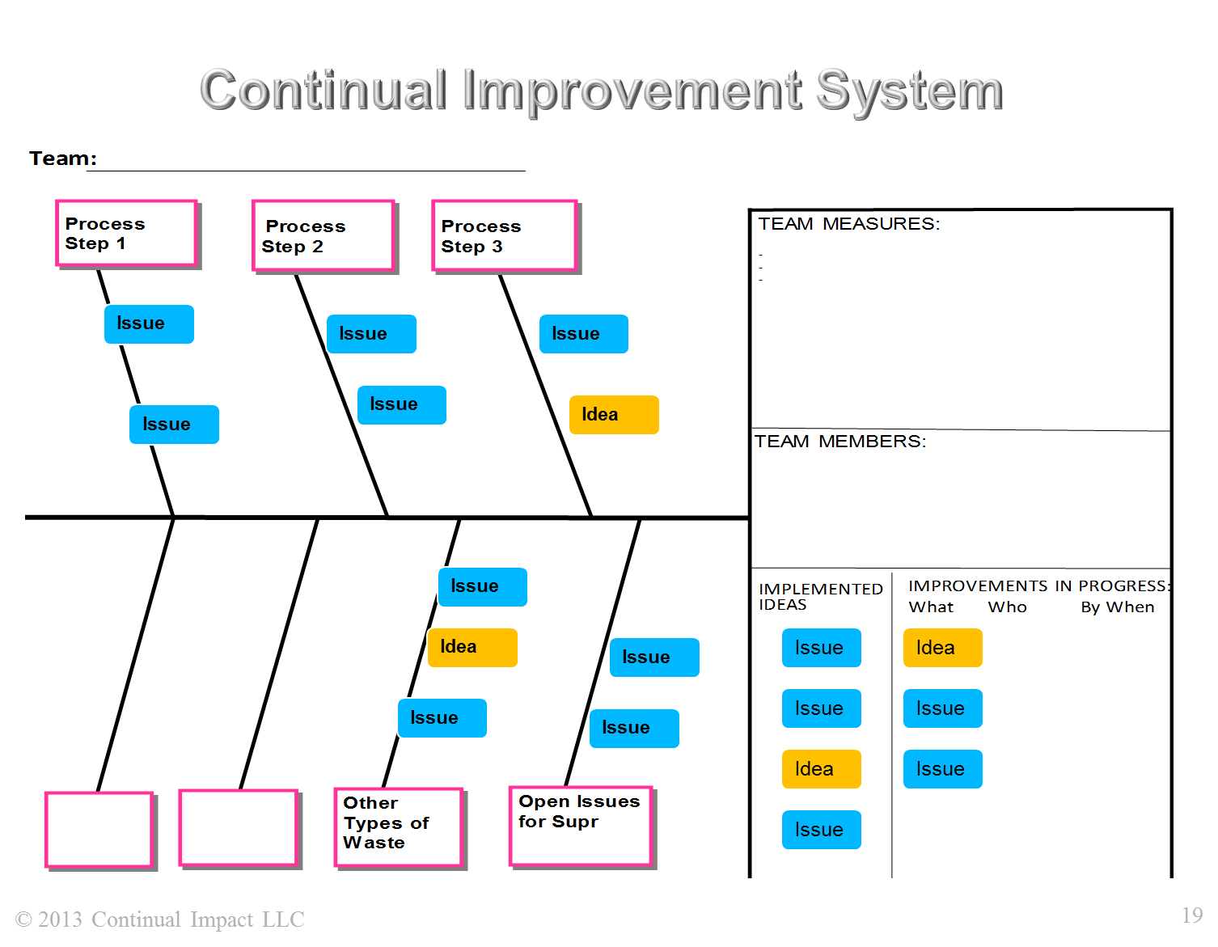
As a team, Continually Improving and Learning Together

Slide 42
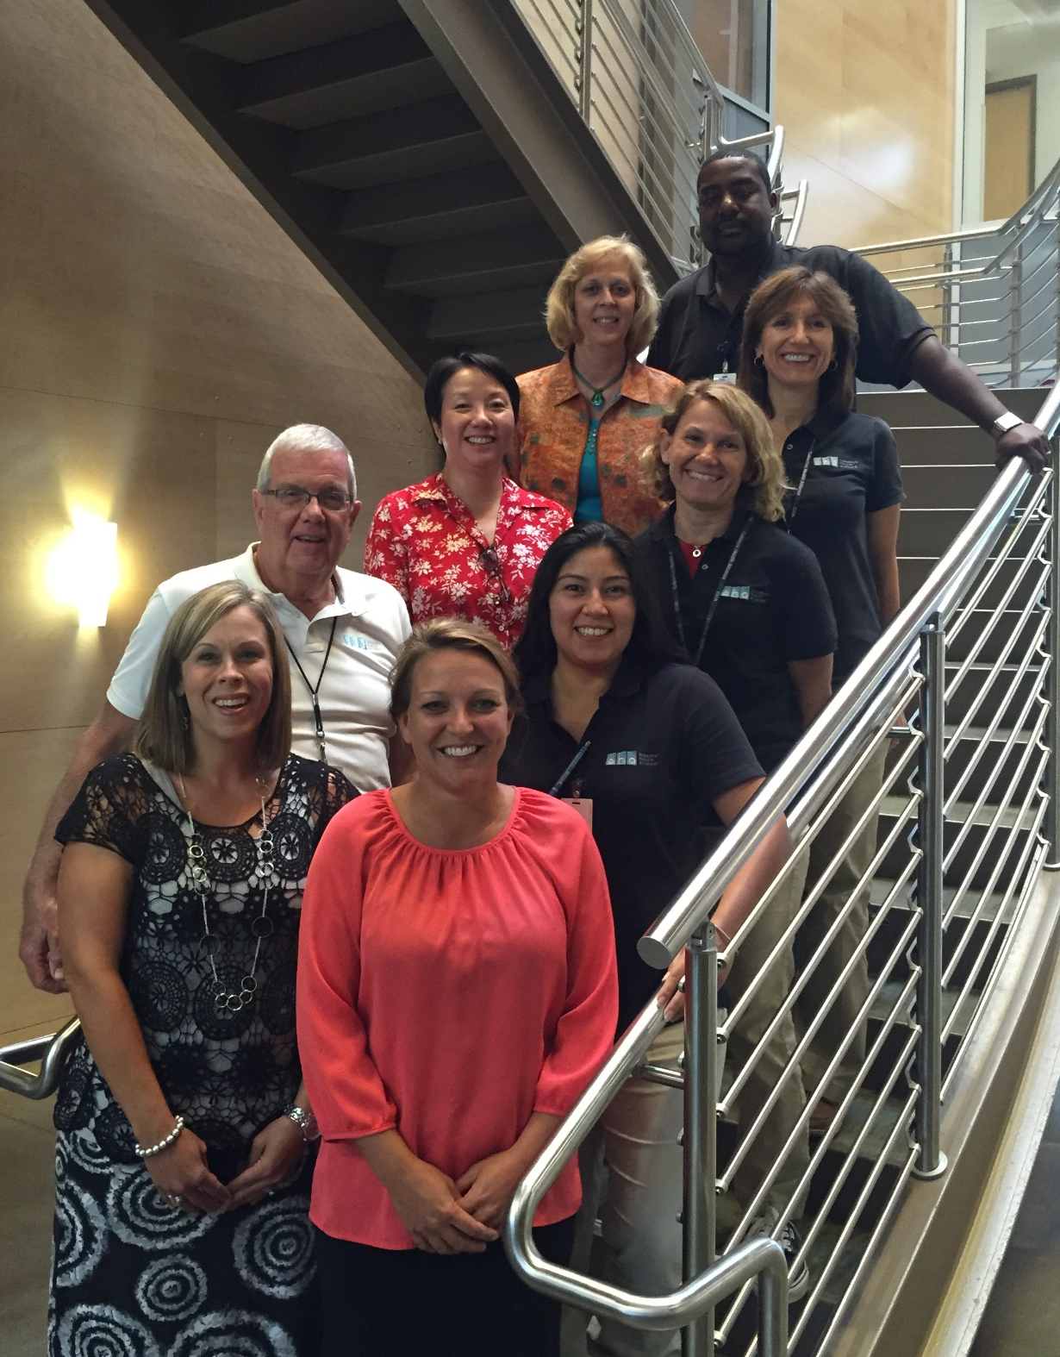
Thank you, Team!

