Slide 1

Improving WCHD’s WIC Scheduling Efficiencies Using Quality Improvement Techniques
2013 Quality Improvement Grantees Learning Congress
September 23, 2013
Whatcom County Health Department
Presented by Allison Williams & Judy Ziels

Slide 2
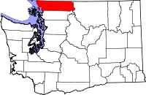
Whatcom County
Total population: 203,500
87,921 (43%) residing in unincorporated areas
73.4 FTEs and annual budget of $18,676,874
Quality improvement experience:
⇨2011: Wrote Performance Management System & QI Plan
⇨2011-2013: Meetings of new Performance Management Team: established criteria for new QI project selection and will be choosing new projects in fall 2013.
⇨2010-2013: Completed three formal QI projects and 3 QI trainings
Funded by the U. S. Centers for Disease Control’s National Public Health Improvement Initiative

Slide 3
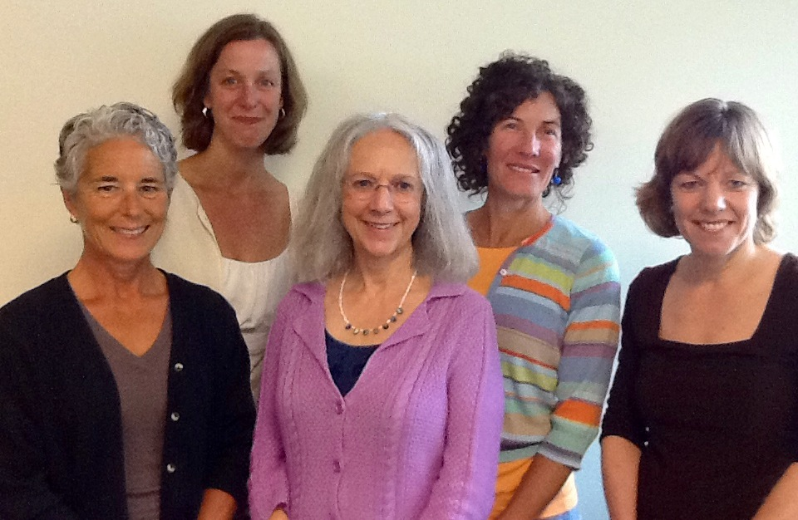
WIC QI Project Team
Kelly Molaski, Nutrition Services Supervisor
Judy Ziels, Parent Child Health Supervisor
Susan Sloan, Performance Management Specialist
Allison Williams, WIC Certifier
Astrid Newell, Community Health Manager

Slide 4
Project Identification
Our overall goal was to increase the number of WIC-eligible clients served by maximizing use of available appointment time.
1,966 WIC-eligible individuals on Medicaid in Whatcom County who were not participating in a WIC program as of July 2013.

Slide 5
AIM Statement
By August 1, 2013, increase the number of eligible WIC clients served by maximizing use of available appointment time.

Slide 6
Project Methodology
PLAN:
Assembled the team
Examined the current approach
Identified root cause
Developed solutions & an improvement theory.
DO: Tested our solution and theory.
CHECK: Studied the results
ACT: Standardizing the improvement & establishing future plans.

Slide 7
Quality Tools – Fishbone (Cause/Effect) Diagram

Slide 8
Client Survey Results
25 clients who missed an appointment during a four-week period were surveyed:
52% had forgotten their appointment.
20% had a transportation issue.

Slide 9
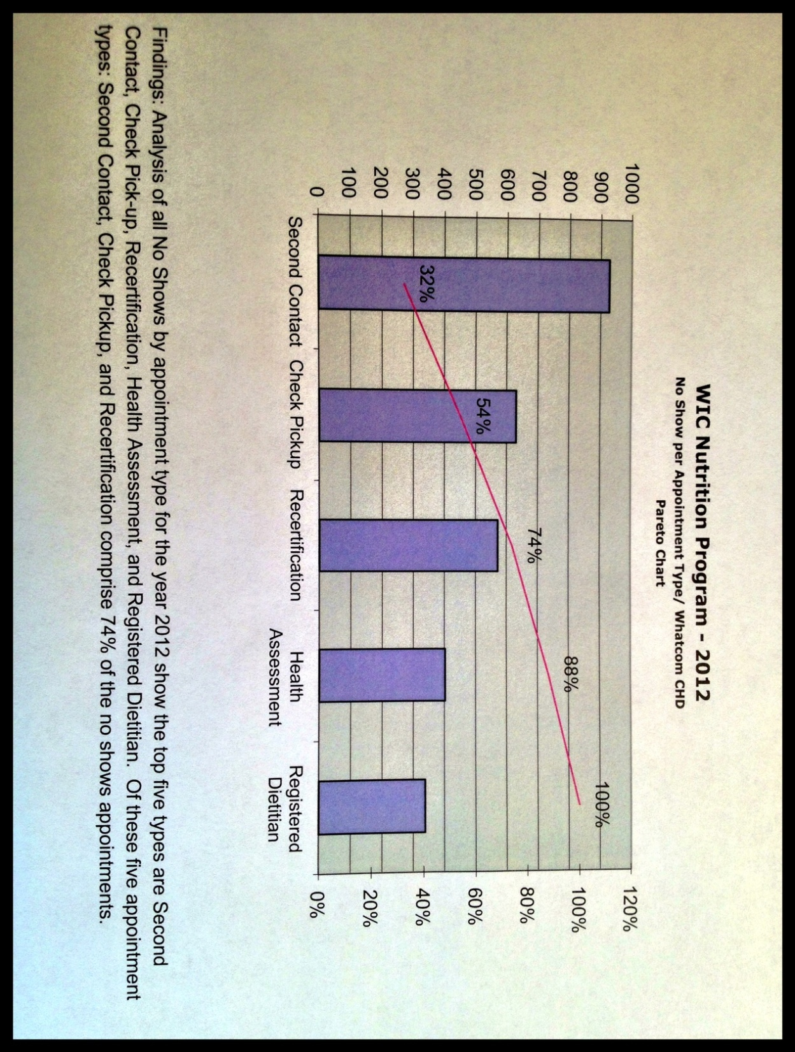
Quality Tools – Pareto Chart

Slide 10
2013 Client Appointment Outcomes
One of our project targets was to decrease unfilled available appointment time by 5%.

Slide 11
Quality Tools – Improvement
Identify Potential Solutions:
Improve our client appointment reminder system by calling two days before the appointment rather than the current practice of calling one day before.
Provide 2C clients with additional options for nutrition education that do not require a formal one-on-one appointment with a WIC certifier.
Develop an Improvement Theory:
If we reduce no show appointments then our overall caseload will go up.
If we have fewer 2C clients needing 15-minute one-on-one appointments with a WIC certifier, then we will have additional appointment time available for new clients.

Slide 12
DO
Test the Theory
For a period of 3 weeks our clerk called clients two days before the appointment as a reminder.
A client Education Room was created to accommodate clients preferring this option to a 15-minute in-person meeting. Clients were surveyed regarding their experience.

Slide 13
CHECK
Study the Results
Calling clients two days prior to an appointment did not improve “no show” rates. Unfilled time actually increased for certifiers from 11% to 15%.
Based on our initial pilot, we estimate that between 360-720 clients/year will use the Education Room (15 minutes of certifier time saved per client) for an annual cost savings in the range of $3,500 to $7,000.
61% of clients using the Education Room appreciated the convenience of this new option.

Slide 14
RETURN ON INVESTMENT
TOTAL FINANCIAL BENEFITS
$5,250.00 X 5 YEARS = $26,250
(mid-range annual savings for 2C education option projected over five years)
TOTAL PROJECT COSTS
$13,942
ROI Calculation: ($26,250 - $13,942)/$13,942 = 0.8828
ROI RESULTS:
After deducting costs, our Community Health Division received 88 cents in return for every $1 invested in this quality improvement project.

Slide 15
ACT
Standardize the Improvement or Develop New Theory
The Education Room option will expand to serve WIC clients that walk-in that have missed their appointment as well as scheduled 2C’s.
An option will be offered where clients can complete their education component online at home.
NEXT STEPS: Establish Future Plans
Improve the accuracy and efficiency of WIC data collection.
Explore the feasibility of text messaging appointment reminders to clients to decrease “no shows.”
Create an effective marketing plan to attract new WIC-eligible clients.

Slide 16
WIC Long-term Goal
Increase the number of eligible WIC clients served by maximizing use of available appointment time.

Slide 17
KEY LEARNING
KEY: 1=not at all and 5=extremely
Question | Average (mean) response 1st Quarter (n=5) | Average (mean) response 2nd Quarter (n=5) | Average (mean) response 3rd Quarter (n=5)
To what extent was I committed to helping achieve the group’s meeting goals? | 4.4 | 4.4 | ⇧ 4.6
To what extent was the discussion open, with sharing of diverse ideas and perspectives? | 4.0 | 3.8 | ⇧ 4.6
To what extent did I say or contribute what I thought was important to achieving our goals? | 4.0 | 4.0 | ⇧ 4.4
To what extent were the goals clear for each meeting? | 3.4 | 3.8 | ⇧ 4.2
How valuable were the goals compared to other things we need to accomplish? | 3.3 | 4.0 | ⇧ 4.2
Overall, how effective was the group in meeting its goals? | 3.8 | 4.2 | ⇩ 4.0
Our Community Health staff has increased their capacity to do quality improvement. Staff is more confident in doing QI and has a better understanding of why QI is important.

Slide 18

For more information, contact:
Judy Ziels,
Parent Child Health Supervisor
(360) 676-6762 x32023
jziels@whatcomcounty.us
Allison Williams,
WIC Certifier
(360) 676-6762 x32240
awilliam@whatcomcounty.us
http://www.whatcomcounty.us/health/
Public Health
Public Health Performance Management Centers for Excellence

Slide 19
The contents of this presentation were selected by the author and do not necessarily represent the official position of or endorsement by the Centers for Disease Control and Prevention.

