Slide 1
QI Grant Award – Administrative Hearings
Rebecca Shultz, MPH
Bureau of Surveillance and Statistics

Slide 2
Introduction
QI Grant Awards sponsored by the National Network of Public Health Institutes (NNPHI)
Award includes:
$5,000
15 hours of QI Coaching
Travel for one person to attend the Quality Improvement Conference
In December 2012, OCHD received this award to reduce staff time associated with the Administrative Hearing process

Slide 3
Background
Administrative hearings are used by OCHD to enforce public health law.
Generally occur when a violation has not been fixed within a given time frame.
Utilized by a variety of OCHD programs.

Slide 4
Background, con’t
In 2011, 477 administrative hearings were conducted.
On average, 6 hours of staff time is required for each hearing.
Additional time is spent scheduling hearings that are ultimately cancelled.

Slide 5
LEAN Process
Derived from manufacturing.
“Preserving value with less work”
Examine all steps in a process.
Identify those steps that do not add “value”.
These steps could be considered wasteful.
Brainstorm ways to eliminate or streamline wasteful steps.
As waste is eliminated, quality improves while costs (staff time, resources) are reduced.

Slide 6
First session
Flowcharts were created by each team prior to the first meeting.

Slide 8
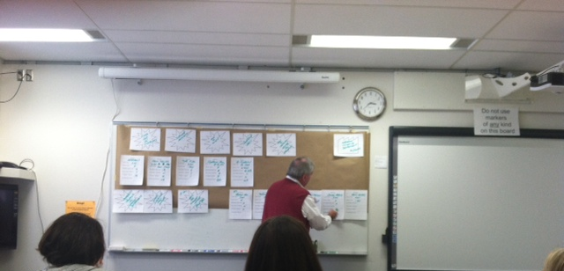
First session
Flowcharts were created by each team prior to the first meeting.
John came equipped with worksheets and long brown “wallpaper”.

Slide 11
Second session
Completed the value stream map and ranked the “starbursts” with sticky notes.

Slide 12
Third session
Reviewed ranked starbursts and brainstormed interventions.
Decided on interventions and assigned person and date.
Scheduled a one-hour follow up meeting in 60 days.

Slide 13
Intervention #1
Delay scheduling of hearings until after second inspection.
Current process: A hearing is automatically scheduled after a failed inspection.
Proposed new process: Change the letter to state that a hearing would be scheduled if violations are not remedied by the re-inspection.

Slide 14
Intervention #1 Results
Letter wording has been changed.
Approval received by Legal and Administration.
Implementation date: 5/1/2013

Slide 15
Intervention #1 Measures
Number of hearing scheduled.
Total time spent on scheduling hearings.
Amount of certified mail being sent.
10 week implementation period with final report due 7/31/13.

Slide 16
Intervention #2
Develop a maximum number of repeat inspections performed by staff.
Current process: Inspectors may make repeat visits until all violations are remediated.
Proposed new process: Standardize the maximum number of repeat visits before a hearing is held.

Slide 17
Intervention #2 Results
There will be only one repeat inspection to any establishment.
After a second failed inspection, a hearing will be scheduled and held.
Implementation date: 5/1/2013

Slide 18
Intervention #2 Measures
Number of inspections conducted.
Total staff time spent on inspections.
Mileage saved.
Number of failed inspections.
10 week implementation period with final report due 7/31/13.

Slide 19
Intervention #3
Move to a more electronic process.
Current process: Hearings are scheduled on a hard copy calendar. Hearing officers receive hard copy documentation before a hearing.
Proposed new process: Develop an electronic calendar in Lotus Notes. Scan and e-mail documentation.

Slide 20
Intervention #3 Results
A request has been submitted to County IT to create a shared calendar.
Documentation can be scanned and e-mailed to hearing officers, or saved to a Shared folder.
Implementation date: 5/1/2013

Slide 21
Intervention #3 Measures
Copy costs.
Storage costs.
Total staff time spent scheduling hearings.
10 week implementation period with final report due 7/31/13.

Slide 22
Lessons Learned
Documenting the process can be very eye-opening!
Many AHA! Moments
Is this worth applying in other areas?

Slide 23
Questions

